Slide 1
Sleep Detection and Alert System for fMRI
Group 25: Jeff Daniels, Amy Mirro, Caroline Farrington
Client: Dr. Dosenbach

Slide 2
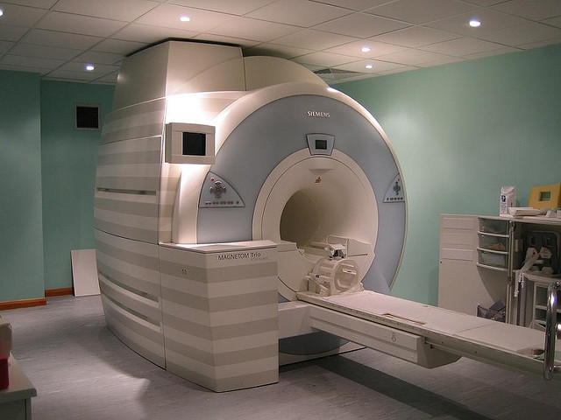
Background and Need
Resting state fMRI functional connectivity
Sleep effects on fMRI data
Why is this important?

Slide 3
Updated Scope
A near real time, fMRI compatible method that takes in several physiological parameters to determine if a patient is sleeping and alert the technician

Slide 4
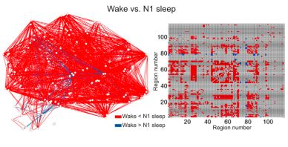
Potential Parameters for Final Design
Any potential parameter had to fulfill two main factors
Correlation between sleep and MR compatible recording
Parameters could potentially come from many different physiological functions
(Tagliazucchi, 2014)

Slide 5
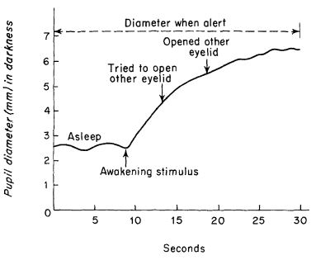
Parameter: Pupil size
Changes in pupil size during drowsiness have been well documented
(Yoss, 1970)

Slide 6
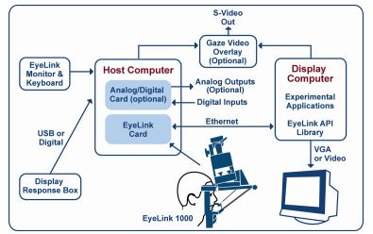
How are eyes recorded in fMRI?
EyeLink 1000 Plus Eye Tracker
Two main parts: core system and mount
Typical set-up for this device is shown to the left
Already in use for resting state recordings
(EyeLink, 2005)

Slide 7
Parameter: Slow eye movements (SEMs)
Previously been shown to occur as a person is falling asleep
Used in the past to alert patients they have fallen asleep during driving simulations
Typically measured using an EOG, not an Eye Tracker

Slide 8
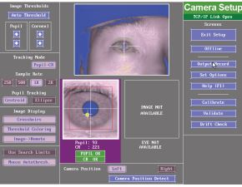
Parameter: Eyelid movement
Many studies measure eyelid movement in relation with SEMs
Alternatively, eyelid movement could be recorded with an eye tracker
Very intuitive parameter

Slide 9
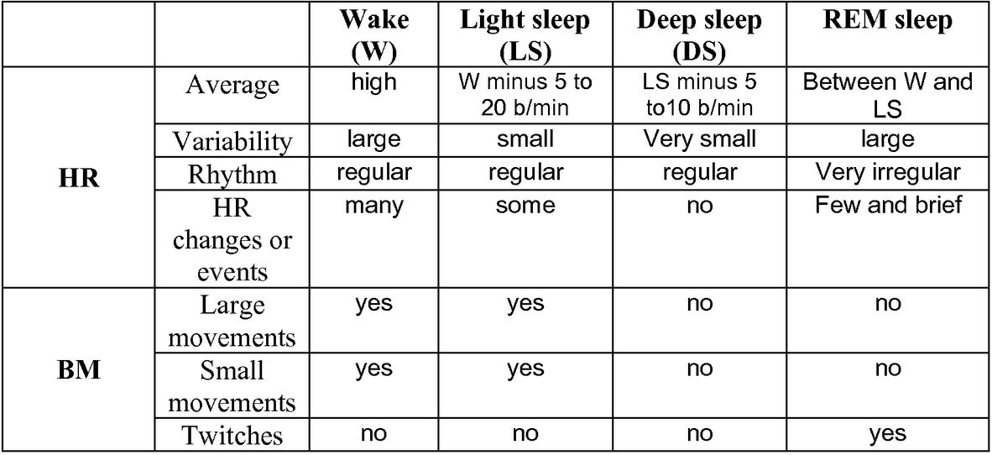
Parameter: Heart rate
Relationship between heart rate and sleep has been researched extensively
Heart rate has been a common vital sign measured in MR environments
(Muzet, 2012)

Slide 10
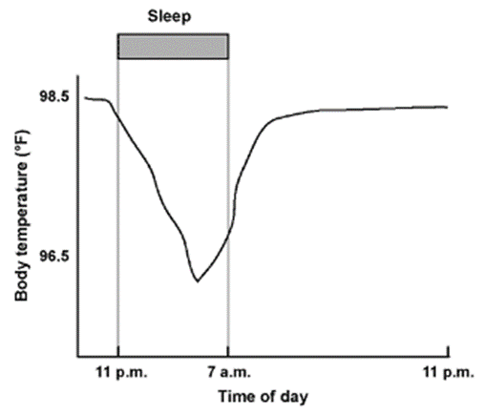
Parameter: Body temperature
Body temperature has been shown to drop as the night progresses during sleep in an average adult
MR compatible temperature measuring devices have been developed
(Sleepdex)

Slide 11
Parameter: Muscle tension
Decreased skeletal muscle activity during sleep than wakefulness
Measured in MR environment with EMG
REM sleep has characteristic effects in muscles
Around the eyes, they are very active
For legs and arms, activity is shut down

Slide 12
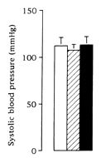
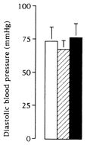
Parameter: Blood pressure
Blood pressure (BP) level and variability decrease during non-REM sleep compared to wakefulness
MR compatible devices (namely, a BP static cuff) have been developed
(Leroy, 1996)

Slide 13
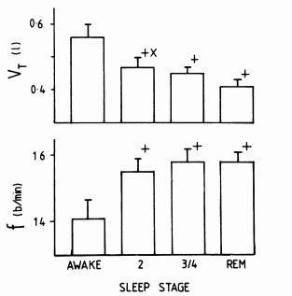
Parameter: Respiratory rate
Respiratory rate can be defined in many different ways
Breathing pattern during all stages of sleep is more rapid and more shallow than wakefulness
Most common MR compatible device is a pneumatic belt
(Douglas, 1982)

Slide 14
Parameter: fMRI BOLD signals
Major differences in fMRI BOLD signals between sleep and wakefulness
No research for BOLD signal processing done during the scan
(Tagliazucchi, 2014)

Slide 15
Analysis: Overview
Factors that were considered for each parameter: MR compatibility, sleep correlation, accuracy, speed, cost, comfort, and availability
Pugh Chart shows ratings for each parameter for each of the factors

Slide 16
Analysis: In-Depth
Pupil size?
Very accurate; already available to client; measurable differences from wakefulness to sleep
Slow eye movements?
EOG data acquisition may lead to problems
Eyelid movement?
SEM correlation involves adhesive that may stress younger patients
Combined with pupil size acquisition, it can determine whether eyes are closed or not
Heart rate?
Accurate; available already; non-invasive recording technique
Body temperature?
Magnitude changes are not substantial enough to make supported claims
Slightly invasive recording technique

Slide 17
Analysis: continued
Muscle tension?
Multiple electrodes required for EMG, leading to stress
Electromagnetic interference
Blood pressure?
Substantial differences in sleep stages; method of recording may be distracting to pediatric patients; error in recording device is on same magnitude as expected changes
Respiratory rate?
Available; distinct differences; magnitude in differences is not large, but statistically different from other stages of sleep
fMRI BOLD signals?
Processing done after images recorded, not during the scan; very complex computations required

Slide 18
Analysis: conclusion and overview
Parameter | Method of Recording | Sampling Rate | Reason for Sampling Rate
Pupil Size | Eye Tracker | 1000Hz | Default rate for EyeLink 1000
Eyelid Closure | Eye Tracker | 1000Hz | Default rate for EyeLink 1000
Heart Rate | Pulse Plethysomgram | 25Hz | Previously shown to provide accurate results (Zhang 2015)
Repiratory Rate | Pneumatic Reparation Transducer Belt | 50 Hz | Sampling frequency of most transducer belts (Biopac, 2014)
Many parameters were invasive and potentially stress-inducing, which could affect the resting state data of pediatric patients
Other parameters had small differences in their value between sleep and wakefulness, which may lead to false positives
Therefore, only four parameters were chosen for the final design

Slide 19
Design Specs
IN GENERAL
Acts in real time (parameters detect sleep and alert in matter of seconds)
MR compatible
Accurate
Non-invasive recording technique
Displays on scan room PC
EACH PARAMETER
Pupil size:
Error of EyeLink device is 0.2% of pupil diameter
Eyelid closure:
Capture 98% of all eyelid closures lasting more than 0.5 seconds
Heart rate:
Chosen pulse plethysmograph should have error less than 2 BPM
Respiratory rate:
Error of pneumatic belt should be less than 2 breaths/min

Slide 20
References
Douglas, N. J., D. P. White, C. K. Pickett, J. V. Weil, and C. W. Zwillich. "Respiration during Sleep in Normal Man." Thorax 37.11 (1982): 840-44. Web.
EyeLink User Manual. Ontario: SR Research, 2005. Print.
Leroy, M., C. Van Surell, R. Pilliere, M.-P. Hagenmuller, P. Aegerter, B. Raffestin, and A. Foucher. "Short-term Variability of Blood Pressure During Sleep in Snorers With or Without Apnea." Hypertension 28.6 (1996): 937-43. Web.
Muzet, Alain Gilles. System and Method for Determining Sleep and Sleep Stages of a Person. Patent WO2012156427A1. 15 May 2012. Print.
Porte, Helene Sophrin. "Slow horizontal eye movement at human sleep onset." Journal of sleep research 13.3 (2004): 239-249.
Tagliazucchi, Enzo, and Helmut Laufs. "Decoding wakefulness levels from typical fMRI resting-state data reveals reliable drifts between wakefulness and sleep." Neuron 82.3 (2014): 695-708.
"The Body's Themoregulation During Sleep." Themoregulation During Sleep. Sleepdex. Web.
Yoss, R. E., N. J. Moyer, and R. W. Hollenhorst. "Pupil Size and Spontaneous Pupillary Waves Associated with Alertness, Drowsiness, and Sleep." Neurology 20.6 (1970): 545. Web.
Shin, Duk, Hiroyuki Sakai, and Yuji Uchiyama. "Slow eye movement detection can prevent sleep related accidents effectively in a simulated driving task." Journal of sleep research 20.3 (2011): 416-424.

Slide 21
Images
https://neurobollocks.files.wordpress.com/2014/09/3081315619_fe0647a5d8_z.jpg
EyeLink 1000 Plus User Manual

Slide 22
Thank you! Are there any questions?

