Slide 1
Sleep Detection and Alert System for fMRI
Group 25: Amy Mirro, Caroline Farrington, Jeff Daniels
Client: Dr. Dosenbach

Slide 2
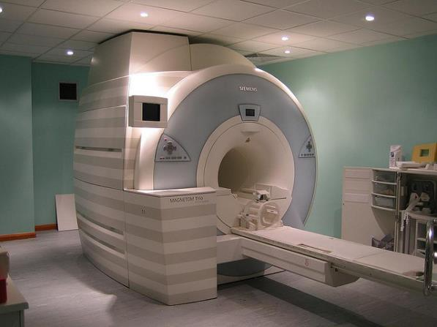
Background
fMRI
Notes:
Explain resting state

Slide 3
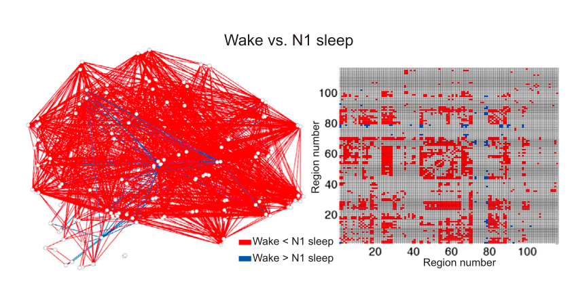
Background
Resting State
Functional Connectivity

Slide 4
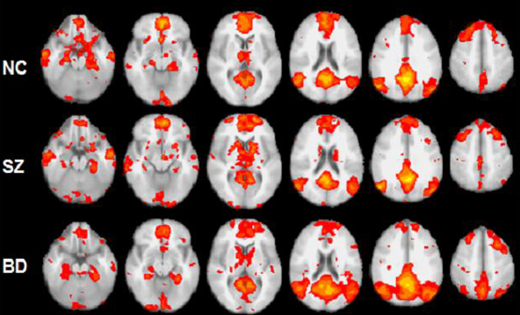
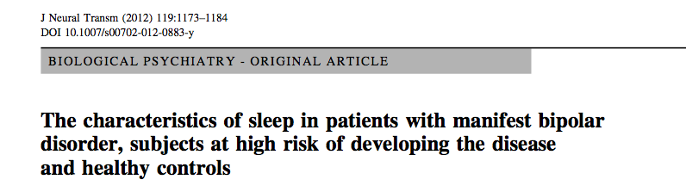
Background

Slide 5
Scope
A near real time, fMRI compatible method to determine if a patient is sleeping and alert the technician

Slide 6
Specs
Acts in near real time
MR compatible
Hardware must fit in head coil(165mm; 60.4mm)
Non-invasive recording technique
Accurate
Displays on scan room PC
Does not obstruct necessary data

Slide 7
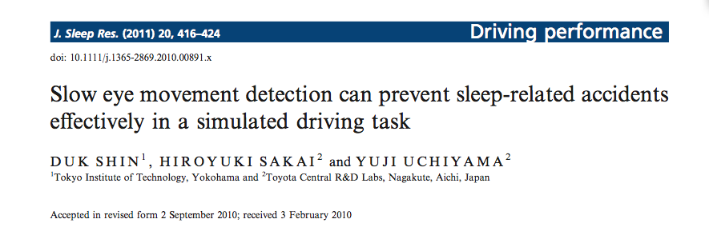
Near Real Time Sleep Detection
Monitoring eye movement
Notes:
Say why these cant be translated straight into imaging- if we chose one how we would have to adapt-
EOG – auditory warning
Agreed with human EOG scoring between 80 -90 % of the time
Requires calibration
Performing and EOG inside a magnet can result in artifacts

Slide 8
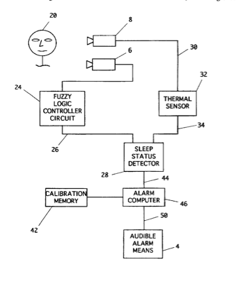
Near Real Time Sleep Detection
Infrared sensor for eyes and breath
Camera for head motion
Notes:
We wont have head motion- ideally

Slide 9
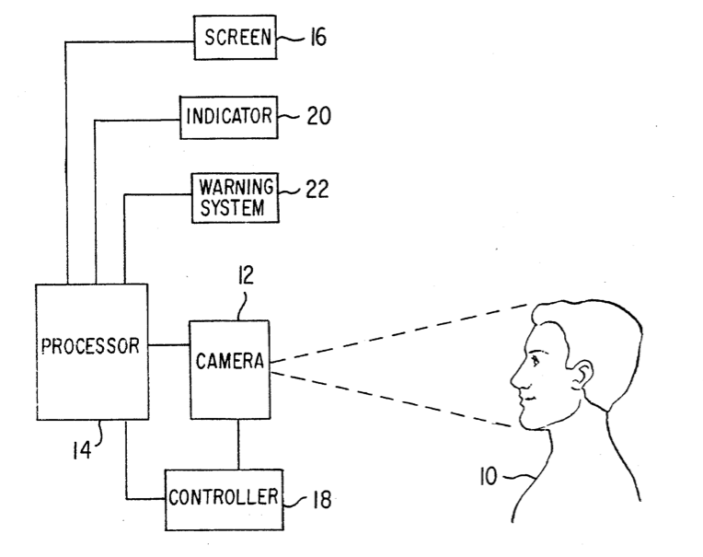
Near Real Time Sleep Detection
Eye tracking system
Compares the current pixel values of the eyes to the first image acquired
Notes:
Designed with camera being far enough away
Restrictions on size of camera

Slide 10
Real Time Tracking in Imaging
Head Motion
Methods exist to:
1. Alert/ Inform Patients
2. Alter image acquisition protocols

Slide 11
Sleep Detection in Imaging
Support Vector Machine
Uses fMRI data to determine if an individual was sleeping during a scan
Applied retrospectively

Slide 12
Adding on to Current Solutions
There are methods for detecting sleep not created for imaging applications
There is real- time tracking in imaging
One group has created an SVM that can recognize sleep after a scan is over
Can we put this all together?

Slide 13
Final Project
Create the first near real time sleep detection system for use in imaging
Improve the quality of images acquired
Prevent wasting of time and money
Ensure the accuracy of resting state fMRI studies

Slide 14
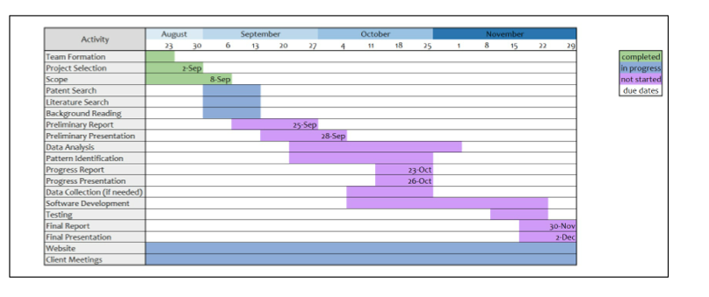
Schedule/ Division of Work

Slide 15
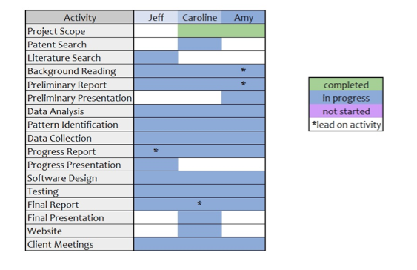
Schedule/ Division of Work

Slide 16
References
Clark, James, et al. “Sleep Detection and Driver Alert Patent” Patent 5,689,241. 18 Nov. 1997
Karl, Van Orden, et al. “Eye Activity Monitor.” Patent 6,346,887. 12 Feb 2002
Shin, Duk, Hiroyuki Sakai, and Yuji Uchiyama. "Slow eye movement detection can prevent sleep‐related accidents effectively in a simulated driving task." Journal of sleep research 20.3 (2011): 416-424.
Tagliazucchi, Enzo, and Helmut Laufs. "Decoding wakefulness levels from typical fMRI resting-state data reveals reliable drifts between wakefulness and sleep." Neuron 82.3 (2014): 695-708.
Thesen, Stefan, et al. "Prospective acquisition correction for head motion with image‐based tracking for real‐time fMRI." Magnetic Resonance in Medicine 44.3 (2000): 457-465.
Thulborn, Keith R. "Visual feedback to stabilize head position for fMRI." Magnetic resonance in medicine 41.5 (1999): 1039-1043.

Slide 17
Images
https://neurobollocks.files.wordpress.com/2014/09/3081315619_fe0647a5d8_z.jpg
https://brainchemist.wordpress.com/2010/11/09/resting-state-fmri-a-novel-approach-to-understanding-brain-dysfunction-in-major-depression/

Slide 18
Questions?

