Slide 1
MRI Sleep Detection & Alert Software Final Presentation
Group 25: Jeff Daniels, Caroline Farrington, Amy Mirro
Client: Dr. Nico Dosenbach, Washington University School of Medicine

Slide 2
Agenda
Overview of Design
Details of Design
Background
Feasibility of Design
Conclusions

Slide 3
Background

Slide 4
Need
Resting state fMRI can provide insight into differences between healthy and diseased brain function
Patients spend an average of 40% of scanning time asleep
Sleep alters brain’s metabolic activity
Altered data must be discarded
→ need a method for detecting sleep during resting state fMRI

Slide 5
Scope
Choose one or more physiological parameters that have been established to be correlated with sleep
Find or create a method to measure these parameters during an fMRI
Develop an algorithm that uses measured data to determine if a patient is asleep
Develop software that will alert the MRI technician if the algorithm detects sleep

Slide 6
Design Specifications
Installation time < 3 hours
MR compatible
Does not interfere with existing software
Sleep alert produced within 20s of initial sleep indication
Non-invasive
Accurate (produces same result as polysomnography at least 80% of the time)
Displays on scan room PC & does not obstruct other necessary data

Slide 7
Overview of Design

Slide 8
Eye Tracking
File Conversion
Data Extraction
Data Filtration
Algorithm
User Interface

Slide 9
Design Details

Slide 10
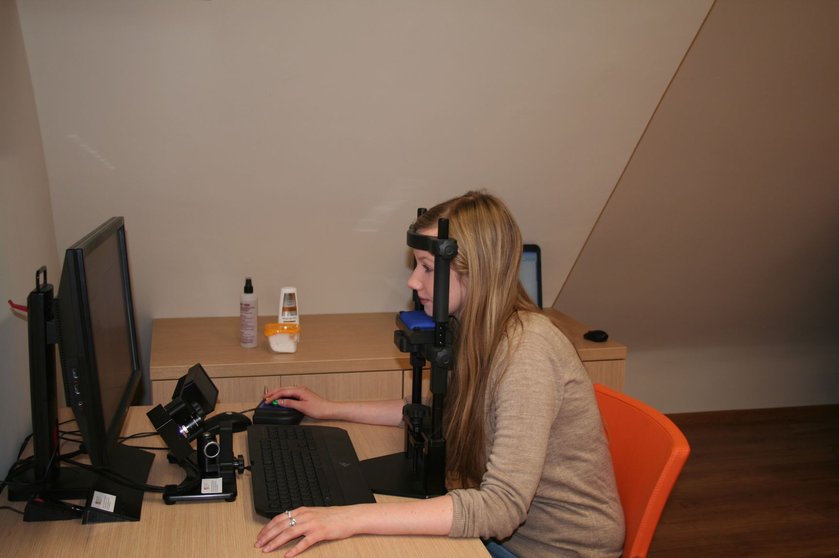
Data Acquisition
EyeLink 1000 Plus Eye Tracker
500Hz sampling frequency
Measure pupil size & eye position
1 second trials
+
http://www.ifa.uni.wroc.pl/linguistics/wp-content/uploads/2014/03/IMG_1722.jpg

Slide 11
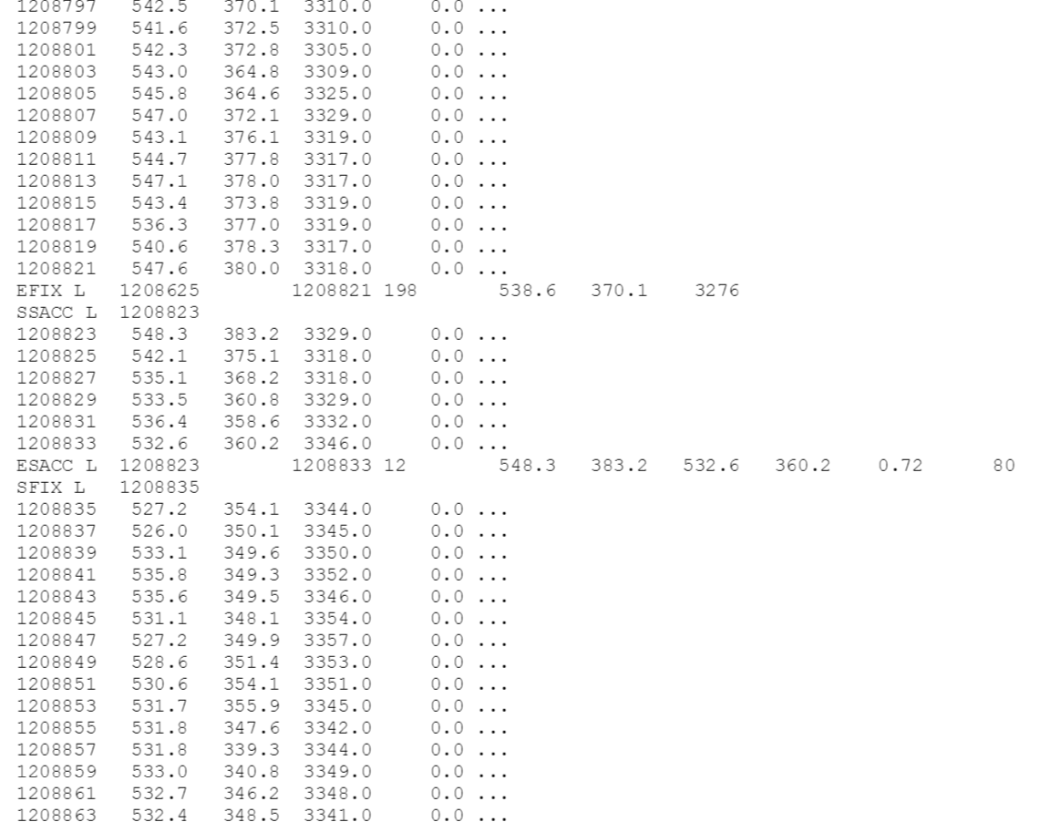
Data Extraction
Saved as EDF file in pre-specified folder
Folder searching loop
Convert to ASCII using “EDF2ASC”
3 columns of data isolated from ASCII file

Slide 12
Algorithm: Fail Safe
Eye closure > 5s indicates sleep
Fail safe “if” statement

Slide 13
Data Processing Overview

Slide 14
Data Filtration
Raw data (pupil size, x pos, y pos) passed through “filtin” function
PUI = sum of changes in average pupil size over set of time intervals
Change in X pos, Change in Y pos
Data passed in 0.2s segments (100 data points); 10 segments for each 2s epoch
Final “filtin” output is a 3x10 matrix
Matrix condensed into 2 values: sum of pupil size changes and total eye drift

Slide 15
Neural Network
Single Layer Perceptron (SLP)
$o=f(V^{T}X+V_{o})$
Binary output
Trained to find weights and bias

Slide 16
User Interface
States “likely awake” or “likely asleep”
Plots PUI and eye drift for the most recent 2 second epoch

Slide 17
Feasibility of Design

Slide 18
Run Time
Total run time = 0.858s
Run time calculated on MacBook Pro 2012; 2.5 GHz Intel Core i5

Slide 19
Design Specifications
Spec | Spec Met?
Installation time < 3 hours | Yes
MRI compatible | Yes
Does not interfere with existing software | Yes
Sleep alert produced within 20s of initial sleep indication | Yes
Non-invasive | Yes
Accurate (produces same result as polysomnography at least 80% of the time) | unknown
Displays on scan room PC & does not obstruct other necessary data | unknown

Slide 20
Limitations
Eye tracker accuracy dependent on user experience level
Limited training data
Limited testing
Eye Tracker not cost effective

Slide 21
Conclusions

Slide 22
Improvements & Future Directions
More data for better training
Testing in MRI environment, by MR technician
Use less subjective sleep indicators for neural network (polysomnography)
More efficient file conversion (EDF2MAT)
Incorporate more inputs
Multi-Layer Perceptron (MLP)
(Belue)

Slide 23
Reflection
What did we learn?
Software development = 90% debugging
Testing is just as important as creating
What would we do differently?
Collect more data
Consider more potential solutions
Prototype earlier

Slide 24
Questions?

